Slide 1

Exam AZ-303: Microsoft Azure Architect Technologies Crash Course
Tim Warner

Slide 2


Tim Warner
Based in Nashville, TN, US
MCT, MVP
Twitter: @TechTrainerTim
Badge: timw.info

Slide 3
Day 1 of 2 Agenda
Introduction
Blah
Exam AZ-303 strategy

Slide 4
Day 2 of 2 Agenda
Content catch-up
Blah
Exam AZ-303 Strategy

Slide 5
Course Materials
timw.info/az104

Slide 6
A Different Kind of Training
Let's avoid slide show fatigue
We'll learn by doing – at least 80 percent demo
Case study approach
This is an expert certification, so we will move quickly and assume intermediate-level Azure skills
5-minute break at midpoint
I’m here to answer your questions – take advantage of this!
Use the Q&A panel

Slide 7
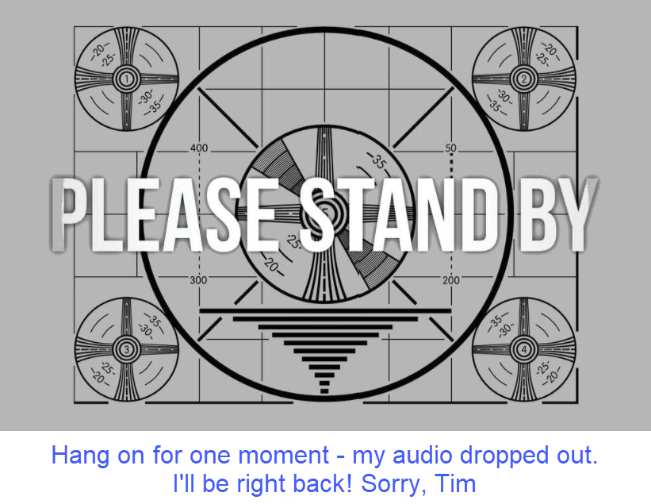
If my audio drops out, you'll see…

Slide 8

Session Recordings

Slide 9
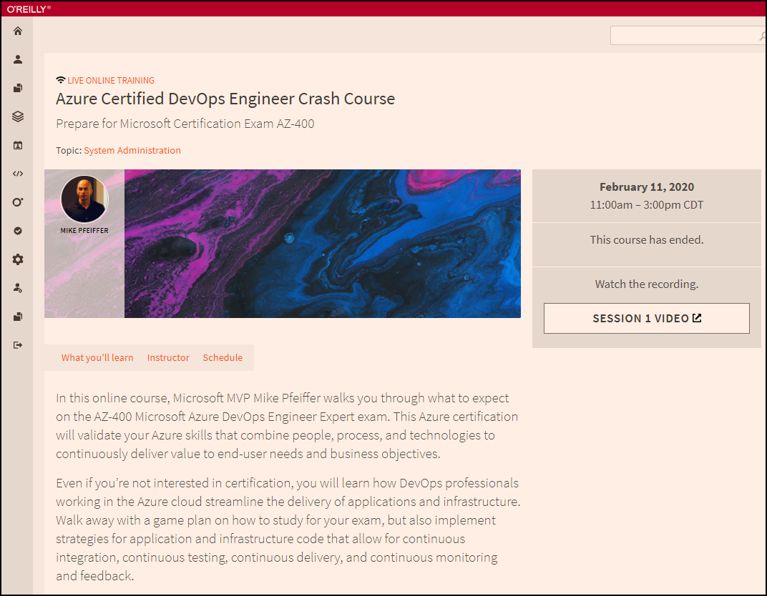
Session Recordings

Slide 10

Session Recordings

Slide 11
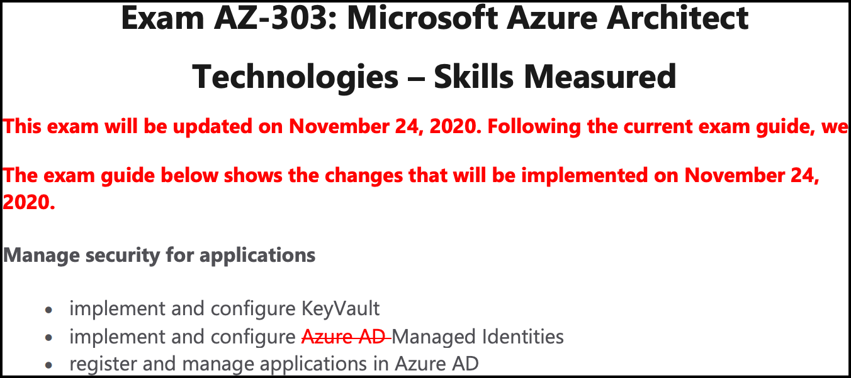
Azure Architect 2020 Changes

Slide 12
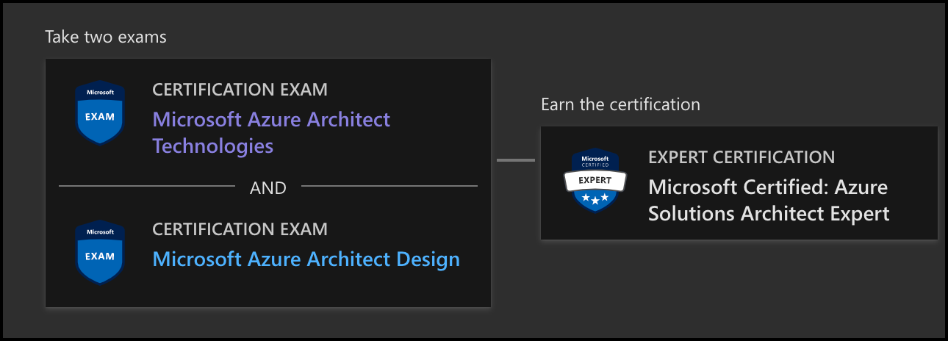
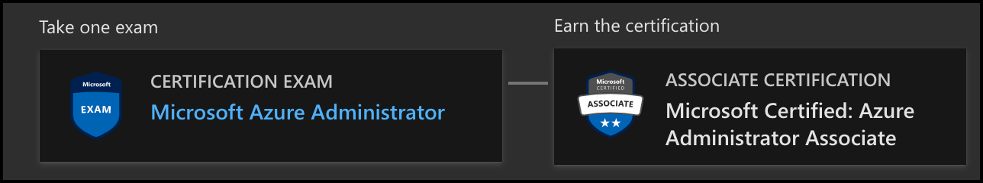
Azure Architect Facts and Tips

Slide 13
Tim's Certification Study Pyramid
Interdependence
Content knowledge
Practical application
Test-taking skills

Slide 14
Thank you!
Course materials: timw.info/az303
Twitter: @TechTrainerTim
Work: timw.info/ps
Web: TechTrainerTim.com

Slide 15
Authentication

Slide 16

Azure Subscriptions

Slide 17

Azure Management Scopes
/ Tenant root
Inheritence:
RBAC
Policy
No inheritence:
Tags

Slide 18

Hybrid Identity

Slide 19

Passthrough Authentication

Slide 20

Seamless Single Sign-on

Slide 21
Azure Storage

Slide 22
Storage Account Replication
1
3
3
2
LRS
ZRS

Slide 23
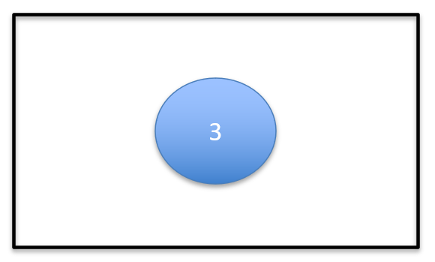
Storage Account Replication
1
3
1
3
2
2
GRS / RA-GRS

Slide 24
Storage Account Replication
1
3
1
3
2
2
GZRS / RA-GZRS

Slide 25
Azure Compute

Slide 26
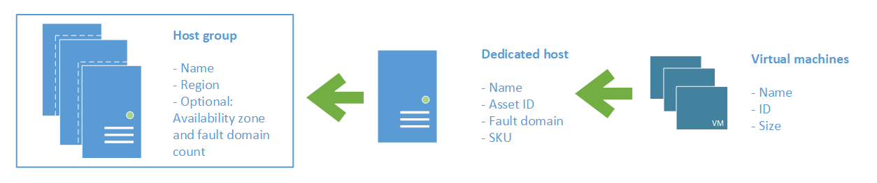
Azure VM Dedicated Host

Slide 27
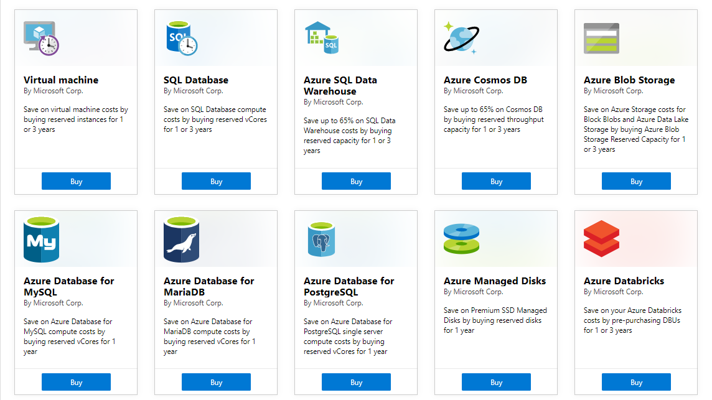
Azure Reservations

Slide 28

VM Scale Sets

Slide 29
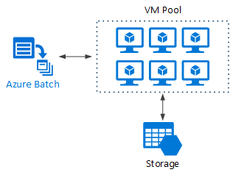
Azure Batch

Slide 30

Availability Set

Slide 31

Availability Zone

Slide 32






Azure App Service
Web Apps
Web Apps for Containers
API Management
Functions
Logic Apps

Slide 33



Running Containers in Azure
Azure Container Instances
Azure Container Registry
Azure Kubernetes Service (AKS)

Slide 34


Docker Lifecycle
https://timw.info/89a04

Slide 35
Migration and Disaster Recovery

Slide 36
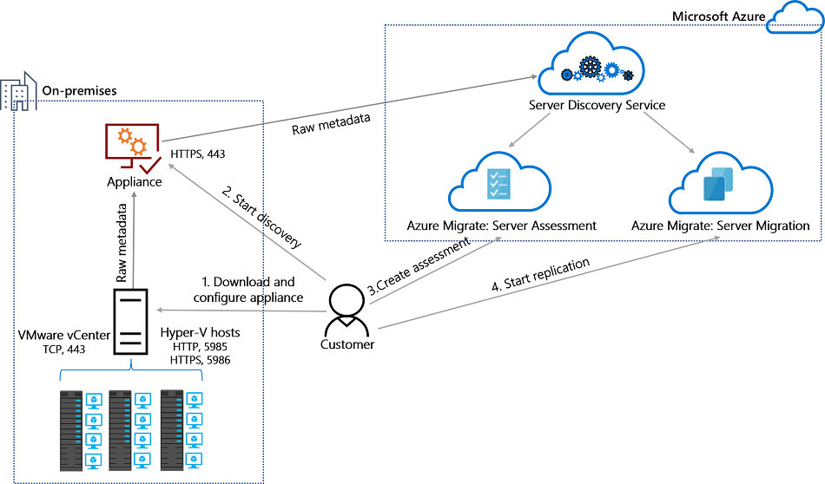
Azure Migrate

Slide 37

Azure Backup

Slide 38

Azure Site Recovery

Slide 39
Load Balancing

Slide 40

VM Networking

Slide 41

Load Balancing

Slide 42

VNet Peering

Slide 43

Hybrid Networking

Slide 44

Network Virtual Appliance

Slide 45

Azure Load Balancer

Slide 46

Application Gateway

Slide 47

Traffic Manager

Slide 48

Front Door Service

Slide 49
Governance

Slide 50

Tenant vs. Subscription

Slide 51
Azure Management Scopes
/ Tenant Root

Slide 52
App Architecture

Slide 53


Docker Container Lifecycle
https://timw.info/3635f

Slide 54

Event Architecture

Slide 55
Data Platform

Slide 56

Always Encrypted

Slide 57
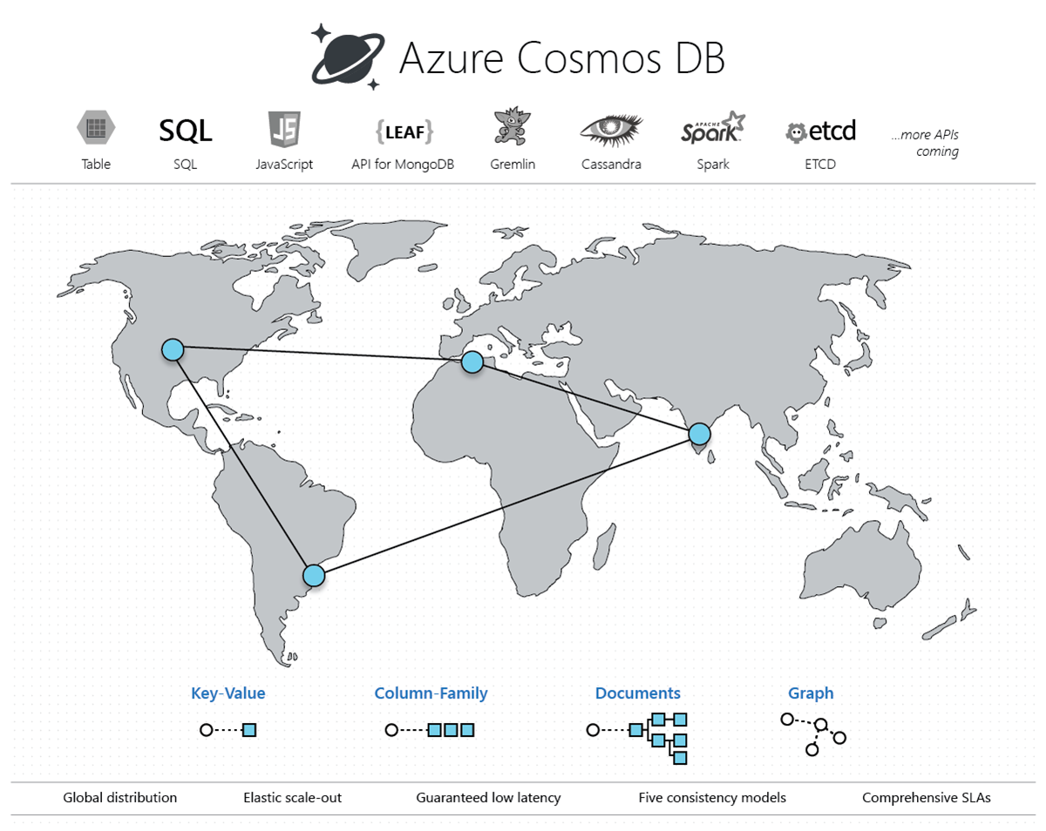
Cosmos DB

Slide 58
Exam AZ-303 Item Types

Slide 59

Multiple Choice

Slide 60
Repeated Scenario
You need to move an Azure VM to another hardware host.
Solution: You redeploy the VM.
Does this solution meet the goal?
Yes
No

Slide 61

Select and Place

Slide 62

Build List and Reorder

Slide 63

Active Screen/Fill in the Blank

Slide 64

Case Study

Slide 65






Performance-Based Lab

Slide 66
Microsoft Online Testing

Slide 67
Microsoft Online Testing Process
timw.info/online

Slide 68

Microsoft Online Testing Process

Slide 69

Microsoft Online Testing Process

Slide 70

Microsoft Online Testing Process

Slide 71

Microsoft Online Testing Process

Slide 72

Microsoft Online Testing Process

Slide 73

Microsoft Online Testing Process

Slide 74

Microsoft Online Testing Process

Slide 75
AZ-303 Exam Strategy
Focus your skills accordingly:
60 percent Azure portal
20 percent Azure PowerShell
10 percent Azure CLI
10 percent KQL
Expect performance-based labs, but be thankful if you don't see 'em

